Slide 1

AW Workflow with Synergist
Prepared by Claire Rollinson, November 2012

Slide 2
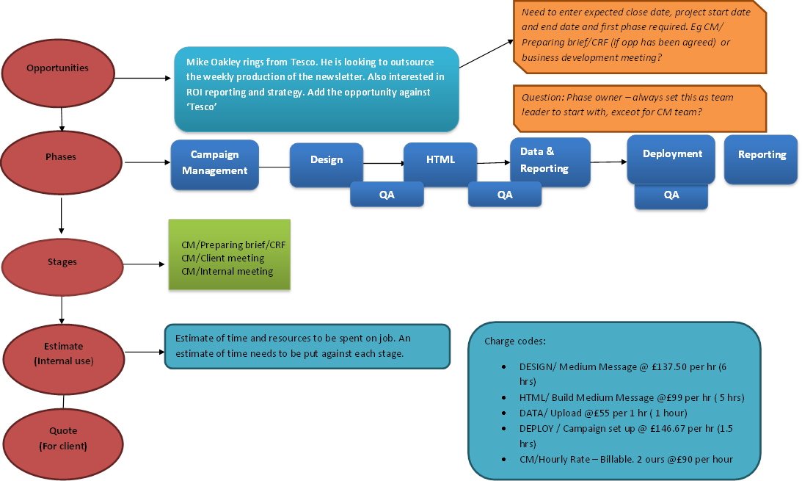
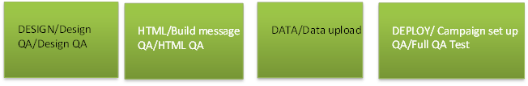
Overview - REDO

Slide 3
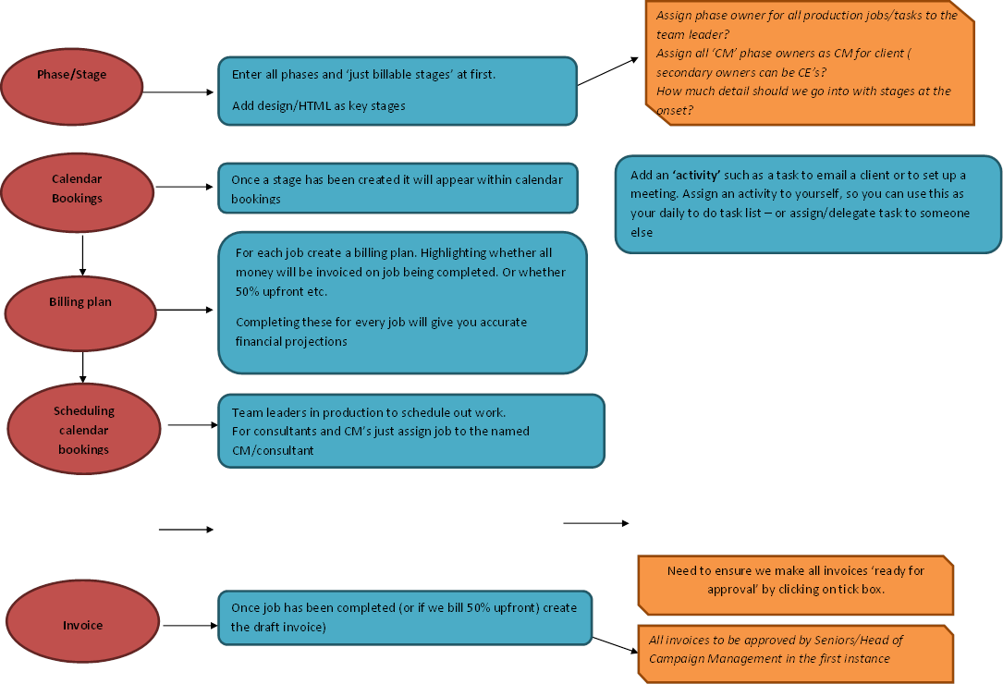
Overview - 2
Requisitions – when a stage is ready to be worked on, of if a repeat stage tasks is required, raise this as a requisition.
Attach brief to requisition request?
It will appear in calendar booking with an exclamation mark to be scheduled out
Timesheets
When you have been assigned a job you need to complete a timesheet entry against this. All CM’s will also need to timesheets at the end of each day, totalling 7.5 hrs a day
Line manager will ‘approve’ all timesheet entries

Slide 4
Contents
Creating your custom ‘views’
Promoting a prospect to client
Adding client contacts
Creating a client template for a master template
Creating a new job/opportunity from a client template
Creating job timelines (GANTT Charts)
Billing plans
Scheduling work into production
Raising requisitions
Production team leaders – scheduling out work
Production (web portal view) picking up, working on and completing tasks
Briefing in and working on amends
Completing and posting, approving timesheets
Creating and approving invoices
Creating and viewing activities
Attachments and adding documents (to be added)
Reports
Appendix one – Clients on monthly retainers
Appendix two – Details of setting a job/opp up from scratch

Slide 5
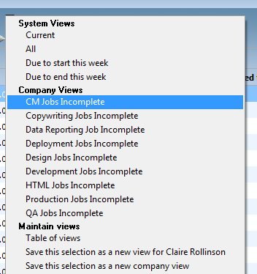
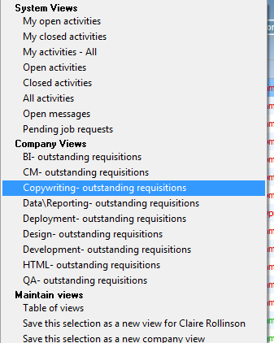
Views
To aid with your searching of jobs, activities you should set up your own ‘views’ at the start of using Synergist.
There already will be a set of company views created which will help you, and which have been set up to benefit the whole company/team ( see below)

Slide 6
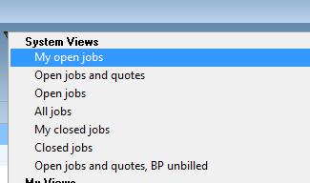
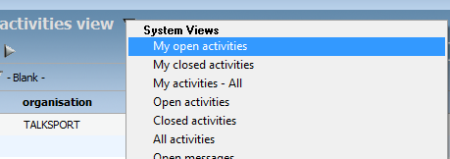
CM views to use
1 ‘my_open jobs’
Is already set up as a system view
2 ‘my_open activities’
Is already set up as a system view

Slide 7
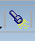
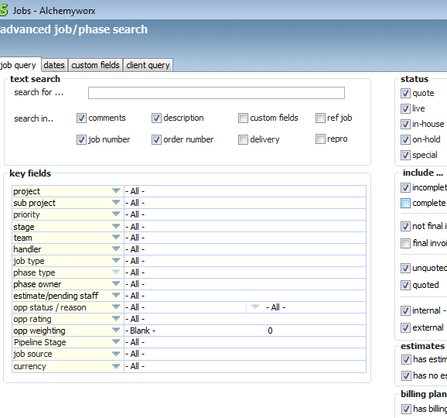
CM views to set up
1. ‘Client live jobs’ view
Eg Aviva live jobs.
- to create this view, navigate to the ‘job’ screen on the left-handside of the menu and then click on the search, icon

Slide 8
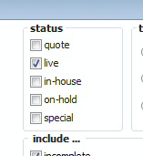
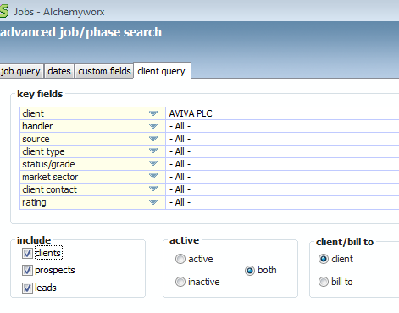
CM views to set up
Status – tick just live jobs
Navigate to ‘client query’ tab and select
the client you want to create it
for

Slide 9
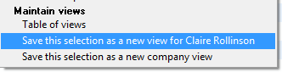
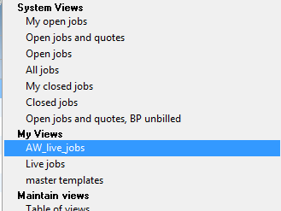
CM views to set up
3. Save the view as a new view for
yourself as ‘client_live_jobs’
4. You will now have this view saved under
‘my views’

Slide 10
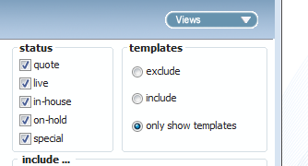
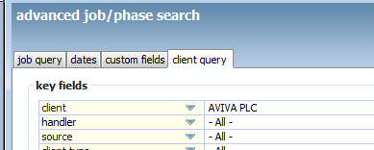
CM views to set up
2 ‘client_templates’
Select ‘all jobs’ under status and select ‘only
show templates’ under templates
Select ‘client’ you wish to view templates for
Underneath the ‘client query’

Slide 11
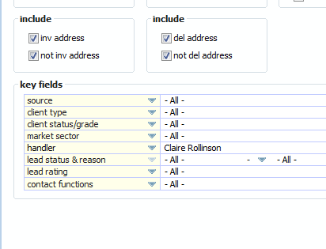
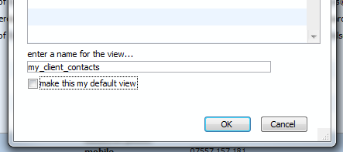
CM views to set up
3 ‘client_contacts’
(To show all the contact you work with/are assigned to’
Navigate to contacts tab, click on the search tab and select yourself as ‘handler’
Save the view as a view for yourself
As ‘my_client_contacts’

Slide 12
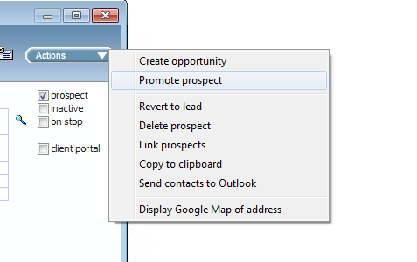
Prospects > Clients
When a prospect becomes a Client, New Business team will convert a Prospect to a Client on Synergist

Slide 13
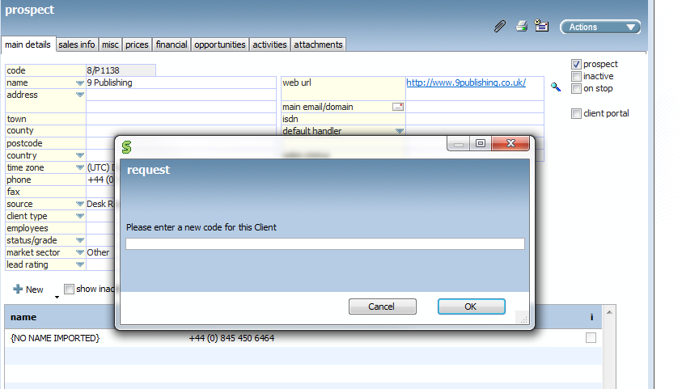
Prospects > Clients - 2
You will be asked to enter a new code for the client which is 8 characters long. Enter the first 8 chars of the client’s name?

Slide 14
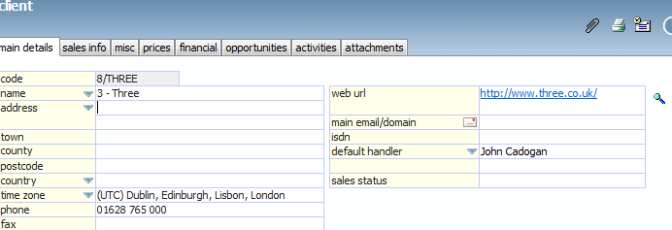
Prospects > Clients - 3
Add the CM assigned to the new client as the ‘default handler’
Signed off SOW/proposal should be saved by Nick in the ‘proposals’ and ‘contracts’ folders.
Ensure ‘client type’ of “US” ”UK” “UK retained,” “US retained” is filled in

Slide 15
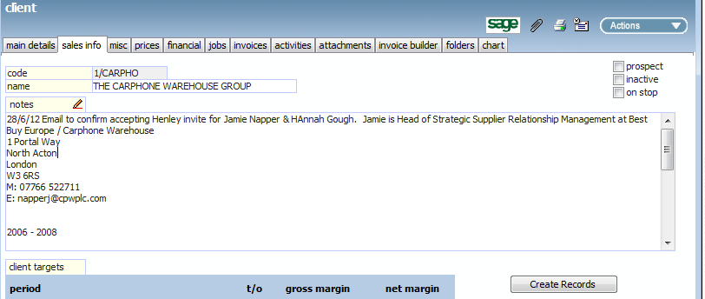
Prospects > Clients - 4
CM to ensure that all client contacts have been added
CM to read any sales info notes and have a handover meeting with new business

Slide 16
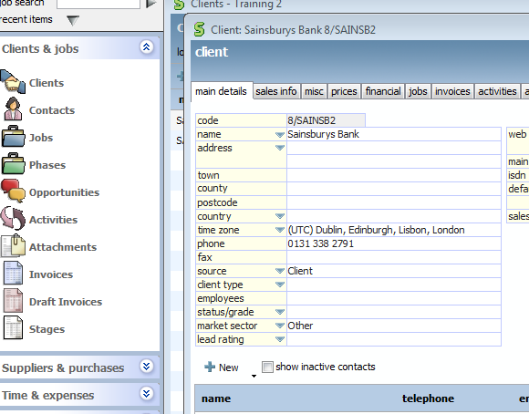
Adding contacts to ‘clients’
Navigate to the client record you want to add the contact for
Click on ‘new’

Slide 17
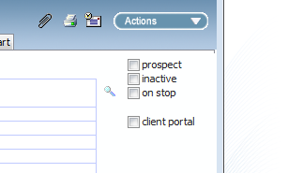
Adding contacts to ‘clients’ - 2
Add title, first name and last name
Add email address and job title
Ensure ‘salutation’ has their first name listed
Tick if they are your day to day contact ‘operational Daily’, ‘billing’ contact or ‘Strategic decision maker’
Add direct phone, mobile number, fax and linked in page if you have it
If they are the person we should send the invoice too, tick the box ‘invoice address’ or ‘cc invoice recipient’
If a contact leaves an organisation please note them as ‘inactive’

Slide 18
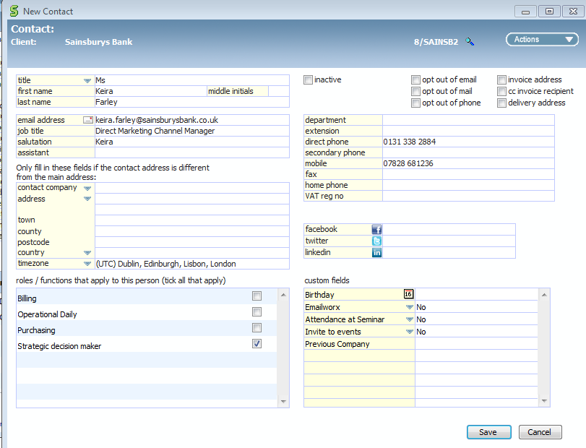
Adding contacts to ‘clients’ - 3

Slide 19
Opportunities
What are they?
This is a quote status Job with a unique Job number. It is the ability to record an Opportunity for some work. This may be with an existing Client or an Opportunity for new business with a Prospect. Opportunities can be Lost/Deadened or promoted to Live
See pages 8 -11 of the user guide for details on how to create an opportunity with ..\..\..\2012\alchemy_worx\synergist\Synergist V1025 User Guide.docx

Slide 20
Opportunities – prospects
New Business and Consulting to own the adding of new prospects and new opportunities to Synergist
New Business and Consulting ‘own’ promoting them to clients
For opportunities against in-life clients CM can promote opps to live jobs once quote has been signed off.

Slide 21
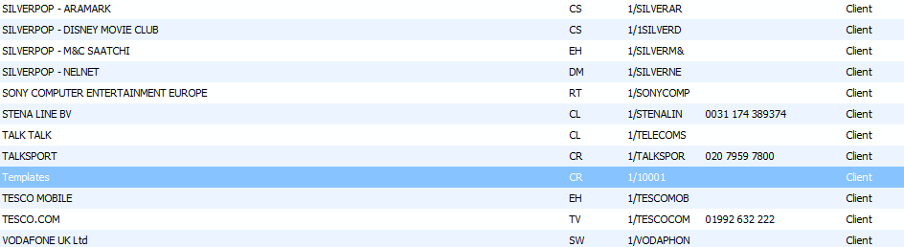
Templates
Majority of rate card jobs have been set up as master templates and have been assigned to client ‘templates’

Slide 22
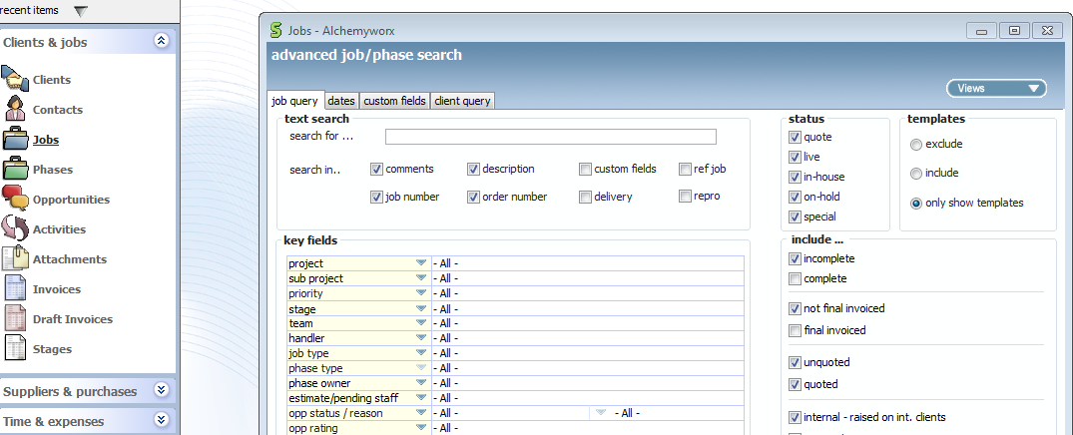
Templates
You can view all ‘master templates’ created by clicking on ‘job’s and then ‘search.’
Tick ‘only show templates’

Slide 23
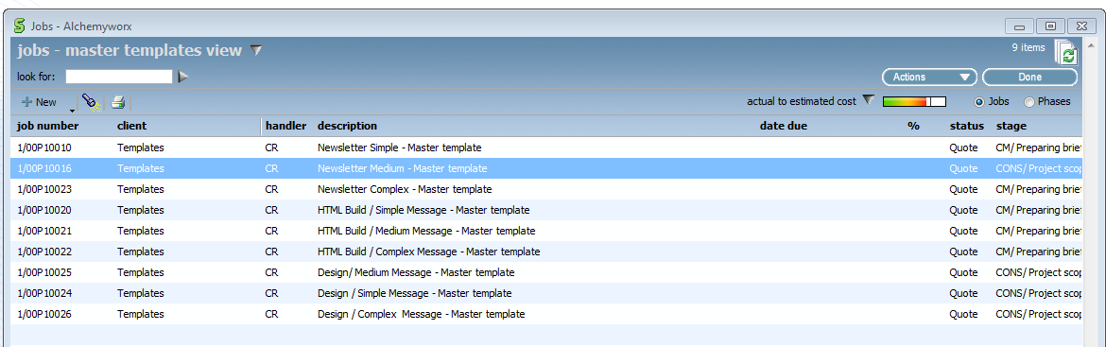
Templates
To create your client templates for regular/BAU jobs please select a master template to create it from the list below

Slide 24
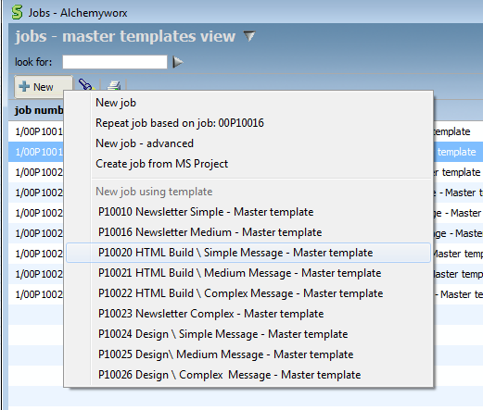
Creating a new ‘client template’ opportunity
Navigate to ‘jobs’, click on new and select the template you wish to base your job on

Slide 25
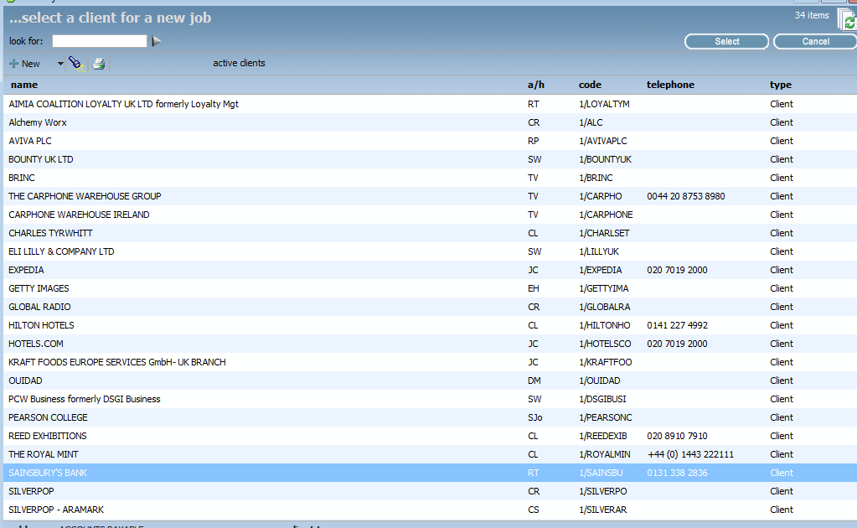
Creating a new ‘ client template’ opportunity - 2
Select the client you wish to make a template for

Slide 26
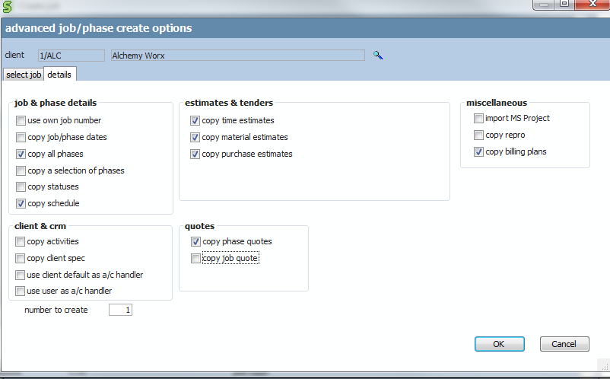
Creating a new ‘client template’ opportunity - 3
Click on ‘details’ tab. All phases, quote details and time estimates should be copied over. Click ‘ok’
Also tick ‘copy job/phase dates’
Also tick ‘copy billing plans’

Slide 27
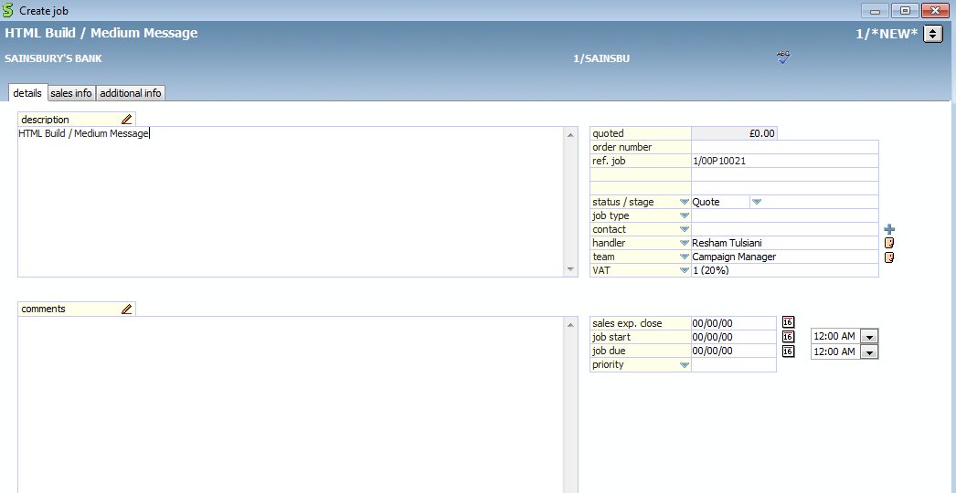
Creating a new ‘client template’ opportunity - 4
Amend job description by removing the term ‘master template’
Status/stage should be set to ‘quote’
Ensure account handler (i.e CM/CE) is updated and correct
Ensure job start date and job due date are set to 00/00/00
Set priority to ‘medium’
Tick the ‘template’ box (bottom left of screen)

Slide 28
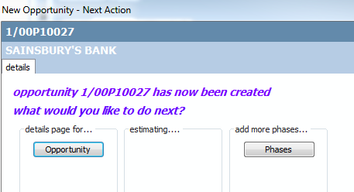
Creating a new ‘client template’ opportunity - 5
Click ‘ok’ and now navigate to details page for ‘opportunity’

Slide 29
Creating a new ‘client template’ opportunity - 6
You have now copied over all the phases, stages, internal charges, and time estimates for that particular rate card job.
You now need to check all estimates have the correct charge codes assigned to them and update any client specific pricing in the ‘phase quote’ section

Slide 30
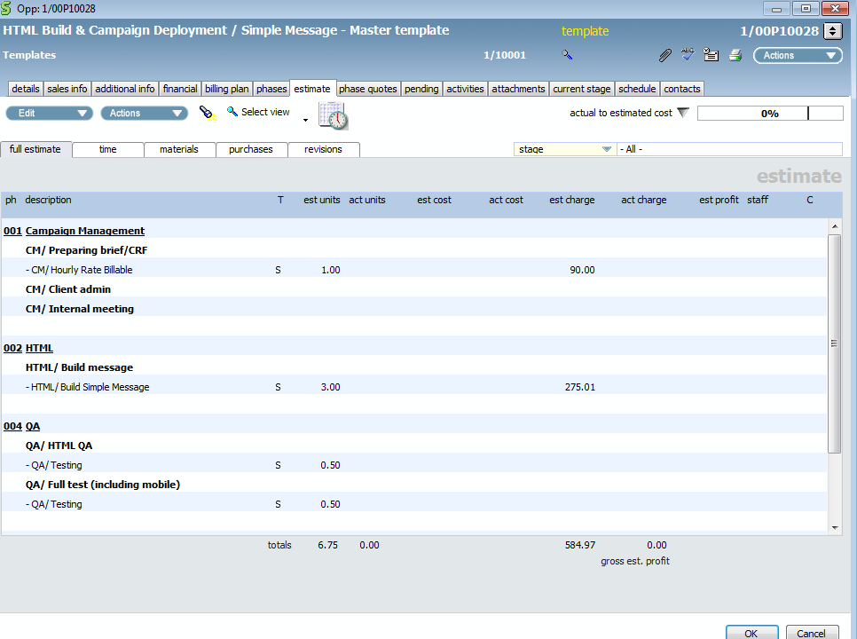
Creating a new ‘client template’ opportunity - 7
Navigate to the ‘estimate tab’ of your client template

Slide 31
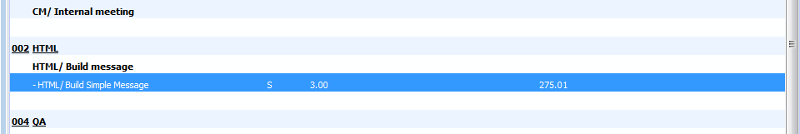
Creating a new ‘client template’ opportunity - 8
Check each charge code description matches to the template you are creating. For example you may need to amend the HTML build charge code and stage to HTML Populate charge/code
Double click on the entry below to get to the estimate screen and amend the charge code and stage here
If you need to amend the charge code and add in new time estimates you can find these details on pages ??? - ??? of this document

Slide 32
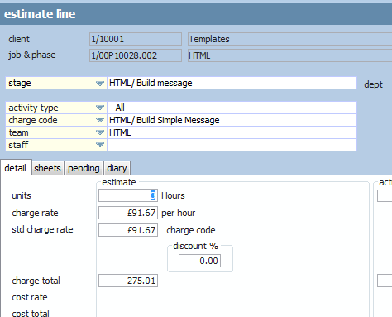
Creating a new ‘client template’ opportunity - 9
If you need to amend the charge code and add in new time estimates you can find these details on pages ??? - ??? of this document

Slide 33
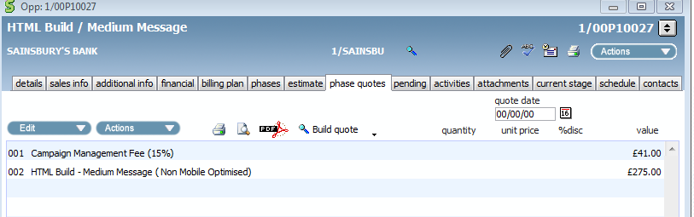
Creating a new ‘client template’ opportunity - 10
Now you need to check and amend the quote for the template
Navigate to the ‘phase quote’ section and update the client charges. Please note the CM fee needs to be manually updated so please work out the CM fee from the costs and add this

Slide 34
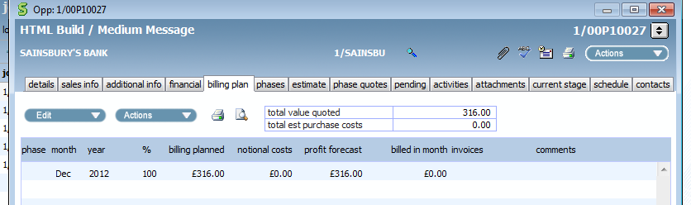
Creating a new ‘client template’ opportunity - 11
Navigate to the ‘billing plan’ tab and check the total is the same as the phase quote total ( if its isn’t, edit the billing plan entry and ensure the ‘synchronize planned value with quote’ is selected)

Slide 35
Creating a new ‘client template’ opportunity - 12
Your client template is now created!

Slide 36
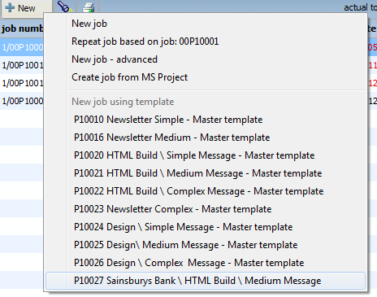
2. Creating a job from a client template
Go to ‘job’s on the right menu bar.
Select new and then select from the template list below or ‘repeat job’ based on client job done previously

Slide 37
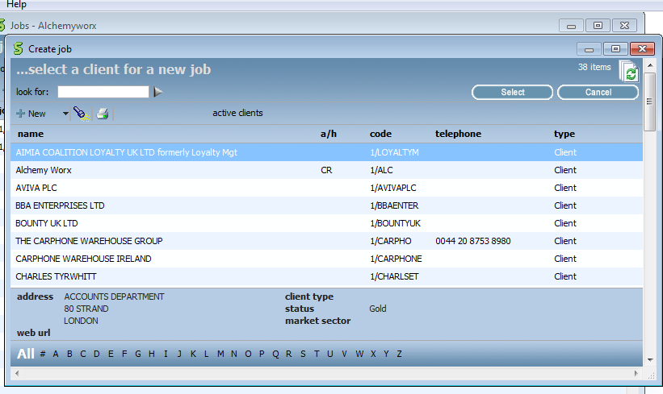
Selecting client
Select client you wish to create a job for by double clicking on client name

Slide 38
Template details to copy over
Click on ‘details’ tab. All phases, quote details and time estimates should be copied over. Click ‘ok’
Ensure ‘copy billing plans’ is ticked

Slide 39
Things to update on job record
Amend job description from ‘template’ to a description of the project completing.
Delete job no in ‘ref.job’ field. This relates to template and not job you are working on
Update status/stage from quote to ‘live job’ and enter the first stage you are going to work on (if job is straight into production)
Add client contact name in the ‘contact’ field
Ensure account handler (i.e CM/CE) is updated and correct
Enter ‘job start date’ and ‘job due’ date
Priority ( High/medium or low) Medium is default.

Slide 40
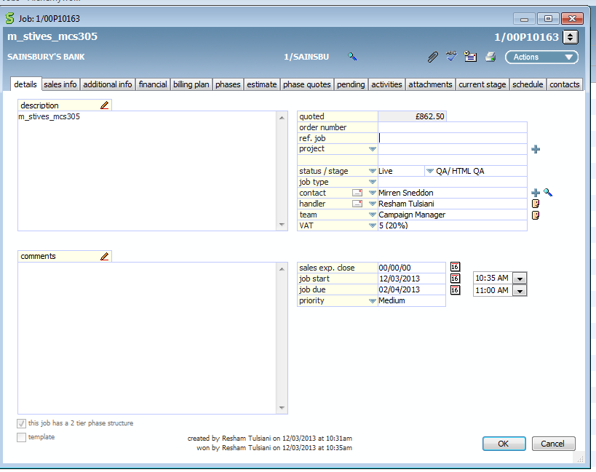
Things to update on job record (2)
.

Slide 41
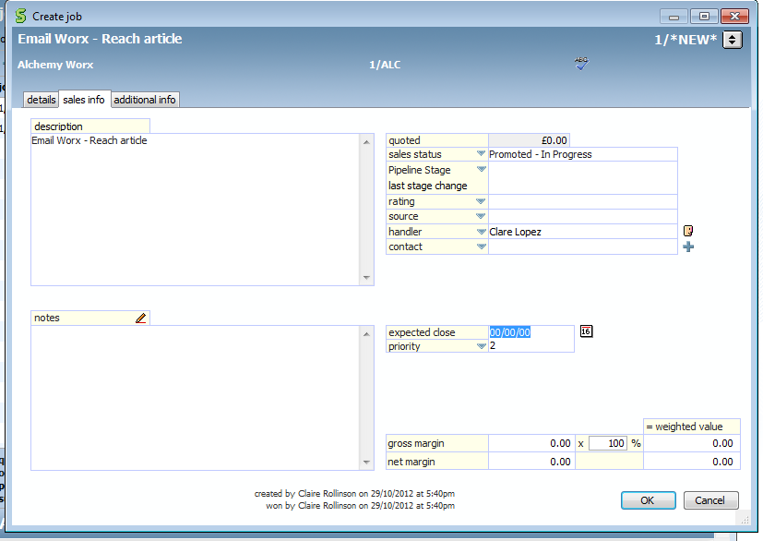
Things to update on template
Sales info.
Ensure client contact details are added
Then click ‘ok

Slide 42
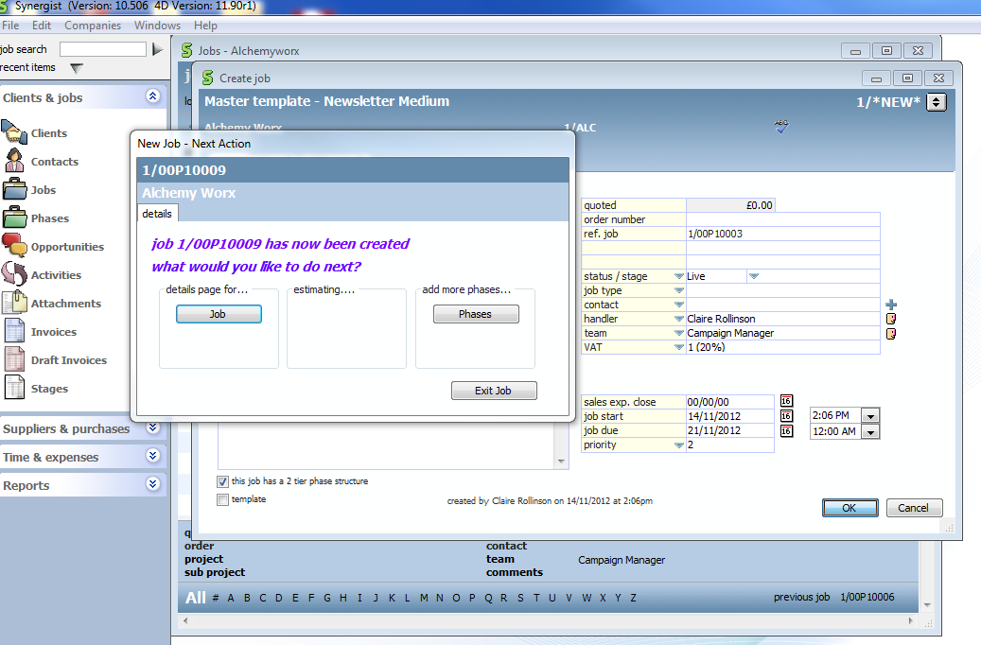
Add details for job

Slide 43
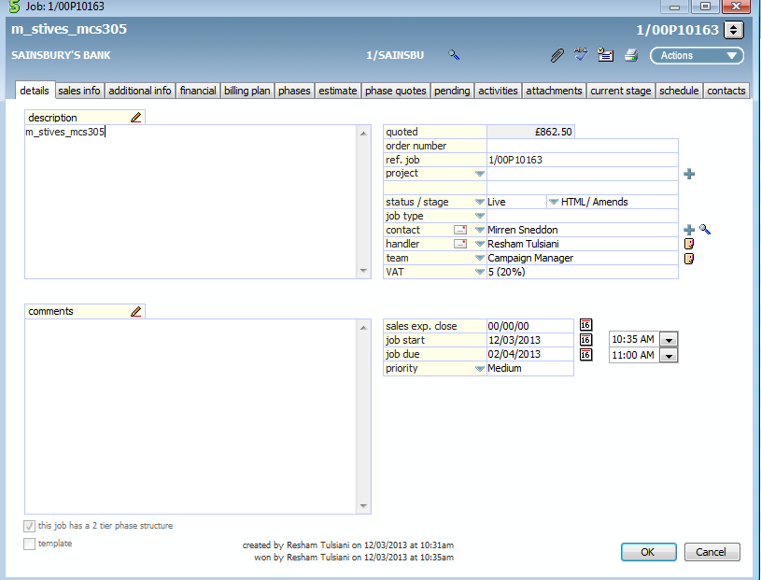
Job record
You have now created your job
You now need to ensure
you only have the relevant
phases required for your
job

Slide 44
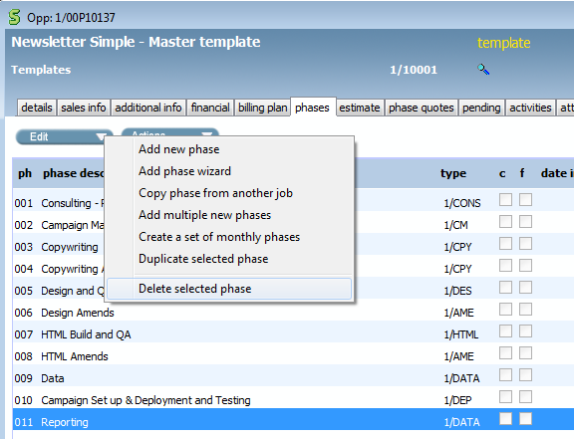
Job record - 2
Navigate to the ‘phases’ tab
Delete any phases that are not required for this specific job

Slide 45
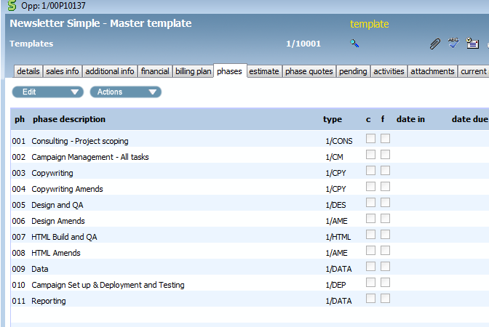
Job record - 3
Now you have just the phases you need for your job

Slide 46
Job record - 4
If you need to add or amend phases complete this now
See slides 161 onwards for adding phases and stages
One thing to ensure is that you have a time estimate against every stage, otherwise the stage won’t show up in calendar bookings when you brief it in

Slide 47
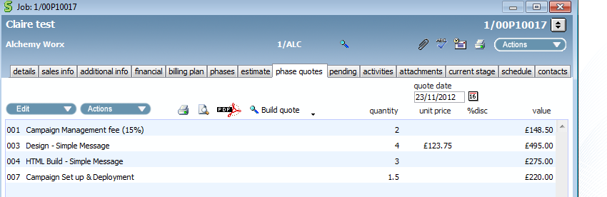
Job record - 5
Phase Quote
Check and update the phase quote for your job
The CM fee will also need to be updated on the phase quote
Recalculate it manually based on job quote total and your client CM charge and enter the revised figure in the CM ‘line entry’

Slide 48
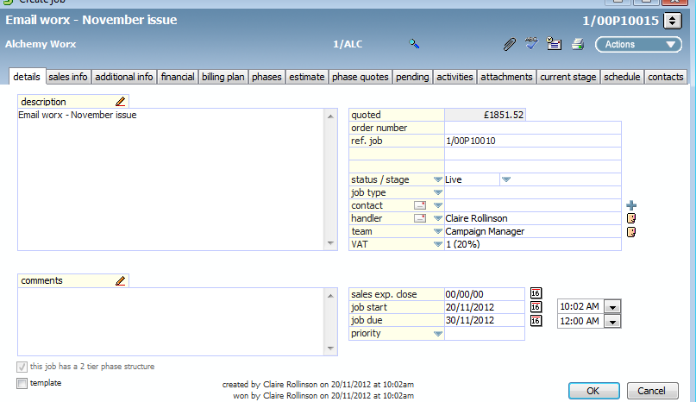
Job record - 6
You also need to add project/stage timelines

Slide 49
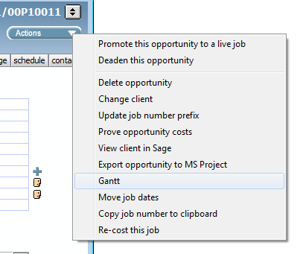
Creating and adding job timelines
Click on ‘action’s button in the top right hand side and select ‘Gantt’

Slide 50
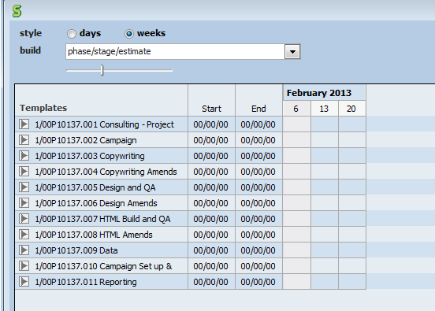
Creating and adding job timelines - 2
At the top under ‘build’ select ‘ job/stage’ view
We need to enter start and end dates for each phase and each stage
As it’s a high level view the dates for most stages will be the same as their phase. For eg design phase and ‘design’ stage
Job start and end date should be populated (from earlier) all other dates will 00/00/00 and will need to completed

Slide 51
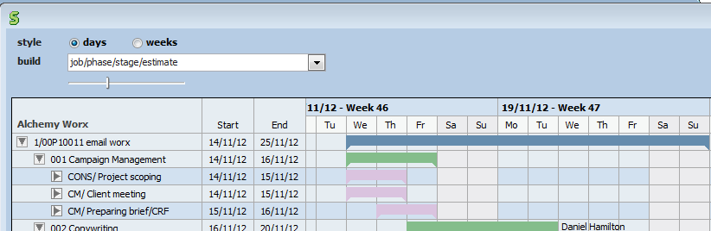
Creating and adding job timelines - 3
Enter dates for each stage starting from the first stage.
You will need to enter the end date first as below, and then the start date

Slide 52
Creating and adding job timelines - 4
Design QA stage to be the same start and end date as design stage
HTML QA stage to be the same start and end date as HTML stage
QA/Full test to be the same dates as campaign set up.
Campaign set up end date should be deployment date

Slide 53

Completed timelines/GANNT
Re do this slide

Slide 54

Billing plans
A default billing plan has been set up for all signed off jobs on job due date to create financial projections
Ensure the billing planned billing is set to 100% of the planned value.
With the ‘synchronize planned value with quote’ box ticked (this will ensure the billing plan is updated with any amend costs you add later)
This will set 100% of the job and all phases to be invoiced on the job due date.

Slide 55

Billing plans - 2
This shows you that 100% of the job (£2,325) will be billed on job due date – November 2012

Slide 56

Billing plan -3
Creating manual plans for large projects which may be billed 50% upfront on start and 50% on completion, you will need to amend your manual billing plan, as below.
For these jobs an extra billing entry will need to be created (on ‘job start date’) and the existing billing entry will need to be amended.

Slide 57

Billing plan -4
Select ‘new billing plan entry’

Slide 58

Manual Billing plan -5
Create an entry with a ‘fixed date’ to job start date
Amend ‘planned billing’ entry to ’50%’

Slide 59

Manual Billing plan -6
Amend the billing entry for ‘relative to’ job due’ date
Amend ‘planned billing’ entry to ’50%’

Slide 60

Manual Billing plan -7
You will now have two billing plan entries, showing you are forecasting to bill 50% of the job when you start and 50% of the job on completion

Slide 61
Scheduling work to production
You are now ready to schedule phases out to the production team!

Slide 62
Scheduling out first phase
General
Once brief has been created you are ready to schedule in work to production
Add brief to the server and ‘to do ‘folders as you would normally
For the phase to be worked on by production you will now need to raise a requisition on the first phase

Slide 63

Raising a requisition
General
CM to raise a ‘requisition’ whenever a phase is ready to be worked on
A requisition is raised by going into the activity section of the stage, within the phase
Navigate to phase, then stage, then to the ‘activities’ tab

Slide 64
Raising a requisition - 2
General
Write details in the subject line and add any further info in ‘details’ section
Add ‘team’ the request is for. (eg design or HTML. This will need to completed to enable the team to view all outstanding requisitions)
the requisition owner is the team leader of the dept completing the work. So for design it would be Luca/ for HTML it will be ?? / copy Dan Hamilton/ Data Robin/ Deployment Canda / QA Andrew Yau
the secondary owner/team member would be the CM and QA (you need to add Andrew Yau and Carmen Quist) tick the ‘immediate alert’ box and the team leader will receive an email notification indicating job is ready. It will also appear in the calendar bookings as a job to be worked on.
Please add due date and time of when the request needs to be completed by
tick the ‘on completion’ box you will also receive a notification it has been completed once the owner ‘completes’ requisition

Slide 65

Raising a requisition - 3
Also add QA as a secondary owner– Andrew Yau and Carmen Quist

Slide 66


Requisition received - 4
The team leader will now receive an email notification and a requisition request under their open activities to schedule out stage task

Slide 67


Requisition received - 5
As long as the CM adds the ‘team’ to the requisition request you will be able to view all non-completed requisitions by team in the company views created below in the ‘activities’ menu

Slide 68
Team Leaders: Production Scheduling jobs to your team…

Slide 69

Log into this version of Synergist:
CLICK HERE!

Slide 70

Another team view….
To see outstanding requisitions for just your team in one view, follow these instructions…..
2
Click on activities on the left handed column
Then click on “open activities view”
Then Company views – HTML, design, deployment etc. for outstanding requisitions
1
3

Slide 71

Example of Team View….
Following the instructions from the previous slide this is the view you will see.

Slide 72

Finding the live jobs…
Step 1. Click on Time & expenses
Step 2. Click on Calendar bookings

Slide 73

Finding the live jobs…
Double click in the top bar next to the word “client” to ensure all jobs that need to be scheduled show at the top…
Jobs that have an exclamation mark against them are outstanding and
need to be allocated to one of your team members. The exclamation mark
is a “requisition”

Slide 74

Reading the requisition…
Right click on the exclamation mark to “open the requisition”
Here you will find all details of the job:
Which CM
Where the brief/assets are saved
Priority
Note: there will be no attachments. The brief will be kept in assets on the server as per the current process.

Slide 75

Scheduling the job: Step 2
Now you need to drag and drop the job into the team members calendar as follows:
Click on the job, so that it is highlighted
Then drag and drop to the person above in your team
As you can see Ben now has the time allocated against him and will have been sent a job alert email
And below the job now has a green tick against it which means it has been dealt with
The job can now be started!

Slide 76
Scheduling the job: Step 1
Change the name of the owner to the person you want to schedule it to. An email will be send to them to inform them of the job
Add yourself as a secondary owner so you receive an email update when complete
Ensure Andrew Yau and Carmen Quist have been added from QA team as well
Check you agree with the “due” time. Talk to the CM if you need more time
Ensure both Tick boxes are checked in "alerts”
Immediate alert
On completion
Then click OK!

Slide 77

Production Logging into Synergist (for those on web licences)

Slide 78

Production – viewing tasks
Navigate to your dashboard
Click on ‘my tasks’ in the top right hand side

Slide 79

Production - viewing tasks
Ensure company is set to ‘Alchemy Worx’
And staff member is set to yourself. This will show all tasks that have been assigned to you.

Slide 80

Production completing task
Double click on ’job phase’ to start work on the task/stage you have been assigned via the requisition request from your team leader

Slide 81

Production completing task -2
You should now be able to view the ‘requisition’ request from the CM, sent to you via your team leader ( if you cannot view it, please click on the ‘activities tab’)
Click on the description to view the request which has been sent to you
The brief/ to do details will be in the project/client folders on the server as usual

Slide 82

Production completing task -3
Click on ‘calendar’ in the top right
By viewing the ‘calendar’ this is another view you can use to see all the tasks that have been assigned to you
Then click on ‘timesheet’ for the job you are working on

Slide 83

Production completing task -4
Once you are happy with everything you can start the job!
Click on the clock to start the automatic timer/stopwatch

Slide 84

Once you have completed job
Click on ‘stop’ to stop the automatic clock timer
Then click ‘add’ to add this time to your pending timesheets

Slide 85

Production completing the task activity
Completing the requisition request
To complete the requisition request, you need to do two things:
Navigate to “my tasks” and ‘complete’ the activity task so the CM/team leader/QA knows it has been completed. See instruction below..
You then need to create a “follow up” so a requisition is sent to the QA team so they know the job is ready for QA. Instructions for this are on the next slide…
Tick the ‘complete’ box

Slide 86

Production completing the task activity
Completing the requisition request
You then need to create a “follow up” so a requisition is sent to the QA team so they know the job is ready for QA:
Already ticked as per previous slide
As well as adding the QA team as secondary owners, also add the CM
Click “follow up”

Slide 87

Production completing the task activity
Once you click on follow up, this will show which is normal. Click OK!

Slide 88

Production completing the task activity
Add a subject line
Add QA Team
Add owner who is Andy Yau
Add secondary owners – Stephanie Cathers
Ensure both Tick boxes are checked in "alerts”
Immediate alert
On completion

Slide 89

Production completing the task activity
Once you have added your time and you have completed the task you will need to ‘complete’ the task and ‘complete’ the requisition request. Note: Only complete the task as per below if you know it has passed QA and been passed back to the CM.
Completing the task
Navigate to “my tasks” tick the box to the left, then click on complete at the bottom (this will now remove it from the scheduling calendar)

Slide 90

QA stage
Once the task has been completed by HTML, Design or Deployment teams the team leader/QA/CM team will receive an email notification it has been done
QA team to have a discussion on who completes the QA stage
The QA staff member will need to select, and drag and drop the correct stage from the calendar bookings to their diary (see slide 71)

Slide 91
QA stage 2
QA staff member to start their stop clock and calculate time spent on job, (following the same process as the production team member described earlier on slide 78)
If job has passed QA:
QA complete requisition and task (following the same process as the production team member described on slide 83) .
An email is then sent to the CM with a link to the JPEG’s or HTML previews (The job is now back with the CM)
If job has failed QA:
QA complete a follow up to Design team (following the same process as the production team member described on slide 84-86).
They should also send an email as per the current process.

Slide 92

At the end of the day…
You need to do two things:
Post all your pending timesheet entries – very important! (instruction below)
The CM should be completing the tasks throughout the day so jobs will disappear from your task list. If one is still showing and you know it is complete, then flag with the CM.
Post all entries at the end of each day

Slide 93
Production posting timesheets
Post all entries at the end of each day

Slide 94

Job is now back with the CM
If CM is happy that job has been completed ok and is fine to send to the client the CM will now complete the stage (except for the ‘deployment ‘ and ‘amends ‘phase .The deployment stage is only completed once the email has been deployed. Amends is completed once signed off)

Slide 95

CM Completing the stage/task
Navigate to the schedule tab, double click on ‘done date’ and tick the ‘completed box’

Slide 96

CM briefing in Amends
Stages of design/HTML/copy amends are already listed for each job as part of the template underneath the phase of ‘design amends’ ‘HTML amends’ ‘copy amends’ or ‘deployment amends’
Double click on the ‘amends’ phase you want to use and navigate to the stages screen.

Slide 97

Briefing in Amends - 2
Double click on the ‘Design/amends’ stage
You will need to add a time estimate and ensure the charge code is completed

Slide 98

Briefing in Amends - 3
Click on ‘actions’ and then select ‘add time estimate’

Slide 99

Briefing in Amends - 4
Add charge code of ‘DESIGN/Amends’
Assign it to design team
Add units of time/estimate for job
Add the amends fee, if the amends are incurring a fee. Otherwise keep it as £0

Slide 100

Briefing in Amends - 5
For each round of amends, you will need to create a new stage entry of HTML , design or copy amends. With each round of amends you will need to raise a requisition – is this correct?

Slide 101

Amends – adding client charges/quote
Click on ‘quote’ tab

Slide 102

Amends – adding charges/quote - 2
Click on ‘edit’ and then ‘add line’
Enter ‘line description’ and ‘unit price’ /charge of amends

Slide 103

Amends – adding charges/quote - 3
The line entry will now be on the ‘phase quotes’
Important! You will need to amend the CM fee if it is a % of job total

Slide 104
Amends – briefing into production
CM and production team member to follow the same process as outlined earlier
CM to raise requisition request
Production to schedule out amends tasks and ‘complete’ tasks, requisitions as they complete

Slide 105
CM – Design/HTML/Copy
The process for briefing in jobs to the design/html/copy/ teams is the same on Synergist
Once the initial stage is complete all future tasks are briefed into production under the ‘design amends’ ‘HTML amends’ ‘copy amends’ phases/stage.
Once you get to the deployment phase/stage there are a few slight differences

Slide 106

CM – Deployment
For deployment, only have one stage against this phase.
So unlike HTML and design, the ‘QA’ part of the job is a separate stage which needs to briefed in separately to the campaign set up
The only stage that should be under deployment phase is ‘campaign set up and deployment’ unless it is a ‘trigger email set up’ which has different costs associated with it
Raise a requisition to deployment and indicate what you need them to do in the SL of the requisition such as ‘send tests’ or ‘send approvals’ etc. All info should also be in ‘to do’ sheet on CRF

Slide 107

CM – Deployment/testing: 3
You also need to brief in ‘full test/render’ test stage/task to the QA team complete if this required after the campaign has been set up
Navigate to the ‘QA: Full test/render test’ phase. (Deleting render test or full test as appropriate)

Slide 108

CM – Deployment/testing: 4
Raise a requisition as usual to the QA team to complete ‘testing’
Team should be set to ‘QA’
Owner to ‘Andrew Yau’
Secondary owners ‘ Stephanie and Carmen’

Slide 109
CM – Deployment/testing: 5
If re-tests need to be briefed in, raise another requisition against the ‘full test’ QA stage stating ‘please retest against previous errors’ in the SL of the requisition

Slide 110
CM – Deployment/testing: 6
The stage of deployment (unlike design/copy/html) should only be completed once the email has been deployed

Slide 111

Once job is complete
As you complete each stage the stage will be removed from ‘calendar bookings’ as a stage need to be worked on until it is completed

Slide 112

Once job is complete
Navigate to the financial tab and tick ‘completed’
This will remove all stages from calendar bookings and remove job from ‘open jobs’
The job is now complete except for the invoice

Slide 113
Timesheets
General
All timesheets need to be completed by the end of each day
All hours need to be added
Hours spent on internal work to be added against ‘Internal time and expenses’
Need to add a timesheet entry for each internal meeting and client meeting you have on job
Roll up all activity on briefing into one timesheet entry at the end of the day based on the no of mins/hours spent on that job

Slide 114

Timesheets – CM’s
Navigate to the ‘time & materials’ menu option
Click on the ‘time & materials’ icon

Slide 115

Timesheets CM’s - 2
Navigate to find your name and double click on your name to navigate to the time entry sheet

Slide 116

Timesheets CM’s - 3
Click on the ‘magnifying glass’ icon next to the client to bring up the client and job, phase and stage you want to enter time against

Slide 117

Timesheets CM’s - 4
Pick up the stage you want to enter time against. For briefing internal and with client select ‘CM preparing brief/CRF’
Enter the number of hours you spent on that job today in total, doing briefs etc
Oncall – enter time here if after hours and we charging the client for it
Weekend – enter time if on a weekend

Slide 118

Timesheets CM’s - 5
Then click on ‘add’

Slide 119

Timesheets CM’s - 6
Continue to add entries for all jobs you have worked on that day
Once completed and you are happy with all entries click on ‘post’

Slide 120

Timesheets CM’s - 7
Assigning time to non client specific work
Select client of ‘Alchemy Worx’
Select job of ‘Internal time and expenses’
Select phase of ‘internal meetings’ or ‘Research and Admin’

Slide 121

Creating a Draft invoice
Once job is fully complete raise draft invoice
Before competing invoice, check all costs have been assigned to phase quote – especially amends and the correct CM fee!
The CM fee will need to be added manually if any costs have changed
dsdfdfdffdfdf
htgghht

Slide 122

Creating a Draft invoice 1
Once job complete raise draft invoice
See page 40 of User guide
Navigate to the ‘financial’ tab on the job
Select ‘new’

Slide 123

Creating a Draft invoice 2
Address details
If the invoice or delivery address is different to the company address select it here
Otherwise select ‘next’ and move onto next screen

Slide 124

Draft invoice - 3
All phases of job are invoiced as default. If you are only invoicing for one phase of job select it here
Select ‘next’

Slide 125

Draft invoice - 4
Select to show all content by phase as built on quote
And select ‘next’

Slide 126

Draft invoice - 5
Click on ‘next’

Slide 127

Draft invoice – 5b
If you need to amend the details on the invoice description. For example to state ‘ Email marketing services jan’ then go back to previous screen and amend ‘quote’ to ‘show wording’ and select ‘job’

Slide 128

Draft invoice – 5c
Now go to ‘edit mode’ and amend the line details of what you want to appear on the invoice (as below)

Slide 129

Draft invoice - 6
Nominal codes now need to be pulled through
Click on ‘edit’ and then select ‘auto analysis builder’

Slide 130

Draft invoice - 7
Check nominal codes descriptions ( are work we have completed) and amounts are correct

Slide 131
Draft invoice - 8
Click on ‘finish’
It is now ‘ready for approval’ once draft complete.
You can no exit invoice screen and press ‘ok’
Claire R/John and Tatiana will ‘approve’ all invoices
Invoice will remain as draft until it is ‘made real’ by finance team

Slide 132

Draft invoice - 9
For approvers (Claire R /John and Tatiana)
On a daily basis navigate to the ‘draft invoices’ screen on the menu bar

Slide 133
Draft invoice - 8
Double click on the invoice you want to approve

Slide 134

Draft invoice - 9
Check the invoice totals.
Check the CM fee is correct
Check all phases and stages have been invoiced for
If you are happy with invoice click on ‘make real’ KR: is this guidance for Finance as Finance should make Real- might want to make clear in doc???

Slide 135

Creating an invoice with multiple jobs
Click on ‘+ New’ ‘Multi -job or phase invoice
Follow the same process as if you were creating a single job invoice
Select all the jobs you want to add to the invoice. (Note the descriptions are at the bottom)

Slide 136

Creating an invoice with multiple jobs - 3

Slide 137

Creating an invoice with multiple jobs - 2
What do we select here to show job and then phases/breakdown of costs – Kate R checking with Karen

Slide 138

Activities
See page 34 of the user guide.
Use activities to delegate/set a task list for yourself.
View ‘my open activities’ for all your ‘tasks/activities’ which you need to complete

Slide 139

Activities - 2
Managers or colleagues may assign you tasks or activities so it is important to always check ‘your open activities’ every day and then tick them ‘complete’ once you have completed them

Slide 140

Reporting
Key reports you may want to use are:
1. WIP – Retro report

Slide 141
Reporting
Client WIP
Filter on all open jobs
In the jobs section you can search for client jobs using the searchlight button and create a client query using the ‘client query’ tab, putting in the client that you would like to view
You can then run a stage export under ‘actions’ which will export to CSV file, which you can use as a WIP

Slide 142

Reporting
2. Staff analysis report

Slide 143

Reporting
3. Period inv date profitability

Slide 144

Reporting
4. Purchase Invoices awaited

Slide 145

Reporting
5. Missing timesheets
This will need to be ran daily by managers to ensure all timesheets have been posted

Slide 146

Reporting
6. Job/Phase profitability

Slide 147

Reporting
7. Costs & quotes

Slide 148

Reporting
8. Job/Phase report

Slide 149

Data viewer
If you want to view data over periods of time, you may be best using the data viewer

Slide 150

Appendix 1 Clients on monthly retainers
For clients that are on monthly retainers, you will need to create a project for the retainer and then assign all the jobs to this project.
Navigate to the ‘projects’ menu item and
select ‘new project’

Slide 151

Appendix 1 Clients on monthly retainers -2
Enter the client name and a description of the project and the period
Tick ‘client specific’ if it’s a client retainer
Amend the ‘handler’ to the CM
Enter the retainer value in the project
Click ‘ok’

Slide 152

Appendix 1 Clients on monthly retainers -3
When you create a new job you will need to assign it the relevant monthly retainer project
On ‘details’ tab next to ‘project’ select the relevant retainer this job is being assigned to

Slide 153

Appendix 1 Clients on monthly retainers -4
When creating the invoice for the retainer based client, navigate to ‘draft invoices’ in the menu tab and then select ‘new’ ‘multi job or phase invoice’

Slide 154

Appendix 1 Clients on monthly retainers -5
Run through the same process with creating the invoice as you would normally.
Except when you get to the ‘job/phases invoiced’ tab select all the jobs that are assigned to that ‘retainer’
Also select the project of the retainer you are billing for

Slide 155

Appendix 1 Clients on monthly retainers -6
Also in the ‘line details’ tab you will need to add delete all entries and replace it with one entry of ‘email marketing services retainer’ and the value.

Slide 156

Appendix 1 Clients on monthly retainers -7
How can we create an invoice without these line entries on? As we need to enter these to show nominal code breakdown?

Slide 157
Appendix 2 Creating an opportunity from scratch

Slide 158

Opportunities – in life clients
Details tab

Slide 159
Opportunities – in life clients
Sales info tab
The status/stage should be set to quote unless its 100% going head and the project is ‘straight into production’
Pipeline stage – If the job is straight into production and has been signed off set this to ‘closed won – 100%’ and rating to ‘active’
If a proposal is needed select option ‘proposal/quote 50%’ and rating to ‘warm’ or ‘hot’ depending on likelihood of converting
Source – if it is a new opportunity from an exsisting client then input ‘client referral’

Slide 160

Opportunities – in life clients
Sales tab

Slide 161

Opportunities – in life clients
1st phase

Slide 162

Opportunities – in life clients
New Opportunity – Next Action
Now add the billable phases and estimate

Slide 163
Phases
What are they?
A section of a Job where all Time, Materials, Expenses and Purchase Orders are recorded. An Opportunity /Job can have multiple Phases but must have a least one.
See pages 9 – 13 of user guide for details on how to add phases
First phase for all jobs to be campaign management, followed by copy/design/QA/html/data/deployment/reporting/business intelligence as appropriate
Phases to be set up by Consulting at quote builder stage.
Set up at least one key stage for each phase

Slide 164
Phases
Creating phases and billable stages for opportunities
Except for CM phase and consulting phases there should only be one stage listed against each phase
Additionally QA stage is an exception and a QA stage should be included in every design and HTML phase

Slide 165
Phase 1 – Consulting: Project Scoping
1st stage to be added is CONS/Project scoping.
(Unless it’s a strategy or business intelligence project then you would add Consultancy as a separate phase)
Charge code to be “CON/ Consultant Non Billable”
Team to be added as ‘consulting’ and staff member to be the assigned consultant
Estimates (When adding estimates, filter by activity type so only see charge codes for that ‘phase type’)
Add a unit of 1 hour
Charge rate should be £0 per hour

Slide 166
Phase 2 – Campaign management: All tasks
Stages to add as appropriate
CM/client meeting (if you are to meet the client to discuss the project)
CM/internal meeting
CM/briefing
Phase and stage owner to be the CM /Exec managing the job
Time Estimates
Add the charge code of ‘CM/Hourly Rate -Billable’ but set charge code to £0
0.25 = 15 mins ( All time increments to be in 15 minutes)
0.50 = 30 mins
0.75 = 45 mins

Slide 167
Phase 3 – Copywriting
Stages to add
COPY/New copy
Assign stage to copywriting ‘team’ adding the expected start and end dates for the stage
Do not add Dan to the staff field at this stage
Estimates
Add charge code of COPY/Medium Message or COPY/Simple Message or COPY/Complex Message a appropriate or COPY/landing page
Add hourly rate estimate and number of hours
COPY/ Short Message. 1.5 hours @£293.33 per hr
COPY/ Medium Message. 3 hours @ £201.67per hr
COPY/ Complex Message. 4 hours @ £206.25 per hr
COPY/Landing page. 2 hours @ £201.67 per hr

Slide 168

Phase 3 – Copywriting example
Below is a time entry estimate for a medium message copy job

Slide 169
Phase 3 – Copywriting Amends
Stage to add
COPY/Amends

Slide 170
Phase 4 – Design
Stages to add
DESIGN/Design
Assign stage to ‘design’ team adding the expected start and end dates for the design stage. Do not add an individual staff member at this stage
Set design as a ‘key stage’ (only one key stage per job can be set)
QA/ Design QA
Time Estimates
Add charge code of DESIGN/Medium Message or DESIGN/Simple Message or DESIGN/Complex Message as appropriate
Add hourly rate estimate and number of hours
DESIGN/ Simple Message. 4 hours @£123.75 per hr
DESIGN/ Medium Message. 6 hours @ £137.50 per hr
DESIGN/ Complex Message. 7 hours @ £188.57 per hr

Slide 171
Phase 4 – Design: cont
Time Estimates (QA)
Add charge code of ‘QA/Testing’ and add team of ‘QA’
QA/ Design QA 0.5 per task @ £0 per hr

Slide 172
Phase 4 b – Design Amends
Stage to add at the beginning
DESIGN/Amends
QA/Design QA
Note – Please ensure you add time estimates to stages before you brief into production otherwise it wont show up in calendar bookings

Slide 173
Phase 5 – HTML
Stages to add at the beginning
HTML/ Build message or HTML/ Populate or HTML / Build landing page
Assign stage to html ‘team’ adding the expected start and end dates for the design stage
Do not add an individual staff member at this stage
QA/HTML QA
Estimates
Add charge code of HTML/ Build Medium Message or HTML/ Simple Message or HTML/ Build complex Message
Add hourly rate estimate and number of hours
HTML/ Populate Complex Message. 3 hours @ 120 per hr
HTML/ Populate Medium Message. 2 hours £125 per her
HTML/ Populate Simple Message. 1 hr @ £ 140 per hr
HTML/ Build Complex Message. 8 hrs @£89.38 per hr
HTML/ Build Medium Message. 5 hours @£99 per hr
HTML/ Build Simple Message. 3 hours @£91.67 per hr

Slide 174
Phase 5 – HTML: cont
Estimates ( QA)
Add charge code of ‘QA/Testing’ and add team of ‘QA’
QA/ HTML QA. 0.5 per task @ £0 per hour

Slide 175
Phase 5 b – HTML Amends
Stage to add at the beginning
HTML/Amends
QA/HTML QA
Note – Please ensure you add time estimates to stages before you brief into production otherwise it wont show up in calendar bookings

Slide 176
Phase 5 c – HTML: Render and text
Stage to add at the beginning
HTML/Create render version
QA/HTML QA
Estimates
Add charge code of HTML/Other
Add time estimate of
HTML/ Other – 0.25 per version against HTML create render version
QA/Testing – 0.25 per version against HTML create render version

Slide 177
Phase 7 – Data
Stage to add at the beginning
DATA/Data upload and DATA cleansing
Assign stage to data, adding the expected start and end dates for the design stage
Do not add an individual staff member at this stage
Estimates
Add charge code of DATA/Upload or/and DATA/ Cleansing
Add hourly rate estimate and number of hours
DATA/ Cleansing. 1 hr @ £55 per hr
DATA/ Upload. 1 hr @ £55 per hr
DATA/ Export. 1 hr @ £55 per hr

Slide 178
Phase 8 – Deployment
Stages to add at the beginning
DEPLOY/ Campaign set up
Assign stage to deployment team, adding the expected start and end dates for the stage
Do not add an individual staff member at this stage
- QA/Full QA Test
Estimates
Add charge code of DEPLOY/Campaign set up or DEPLOY/Triggered set up or DEPLOY/Resend and an extra estimate of DEPLOY/Dynamic rule if appropriate
Add hourly rate estimate and number of hours
DEPLOY/ Campaign set up. 1.5 hr @ 146.637 per hr
DEPLOY/ Dynamic rule. 0.25 @ £40 per hr
DEPLOY/ Dynamic segment. 0.25 @ £140 per hr
DEPLOY/ Triggered set up. 2.5 hrs @ £154 per hr
DEPLOY/ Resend. 0.5 per version @ 190 per hr

Slide 179
Phase 8 – Deployment: cont
Time Estimates
Add charge code of ‘QA/Testing’ and add team of ‘QA’
QA/ Render Testing. 0.25 per version @£0per hr

Slide 180
Phase 8 b – DM rendering and full QA test
Stages to add at the beginning
DEPLOY/ Send render test
QA/Full QA Test
Time Estimates
DEPLOY/ Send render test
- Add charge code of ‘HTML/other’ and team of ‘deployment’
- Add time estimate of 0.25 per version @ £0 per hr
QA/Full QA Test
Add charge code of ‘QA/Testing’ and add team of ‘QA’
QA/ Render Testing. 0.25 per version @£0per hr

Slide 181
Phase 9– Reporting
Stages to add at the beginning
BI/Basic Metric report
Estimates
Enter 1 hr estimate for a Campaign Snapshot report

Slide 182

Phase Quotes
Quick quote or quote builder advanced to be used
The quote entry lines will need to be amended at this stage, with all non billable items deleted and all line descriptions amended so they are ‘client friendly’
Enter quote date to todays date
See page 23 of user guide for details on quoting - link here
-

Slide 183

Opportunity now created
Once opportunity/quote is accepted, promote to a live a job
(be aware you can only promote quote to a live job if prospect has already been promoted to a client)
You will also need to update ‘sales stage’ to ‘100% won’
See pages 32 of the user guide
The 1st phase/stage can now be worked on
If this opportunity was with consulting, at this stage it will be passed onto the CM to take-over/complete. An alert would be sent to the account handler once job has been promoted

Slide 184

Opportunity is now live job
The CM is now responsible for the job
CM to write/collate brief and assets
This will be entered against stage ‘Cm/preparing brief’
Set up an internal meeting to discuss and agree job and ‘phase timings’

